Slide 1

Chapter 1
Introduction to Cryptography
and Data Security

Slide 2
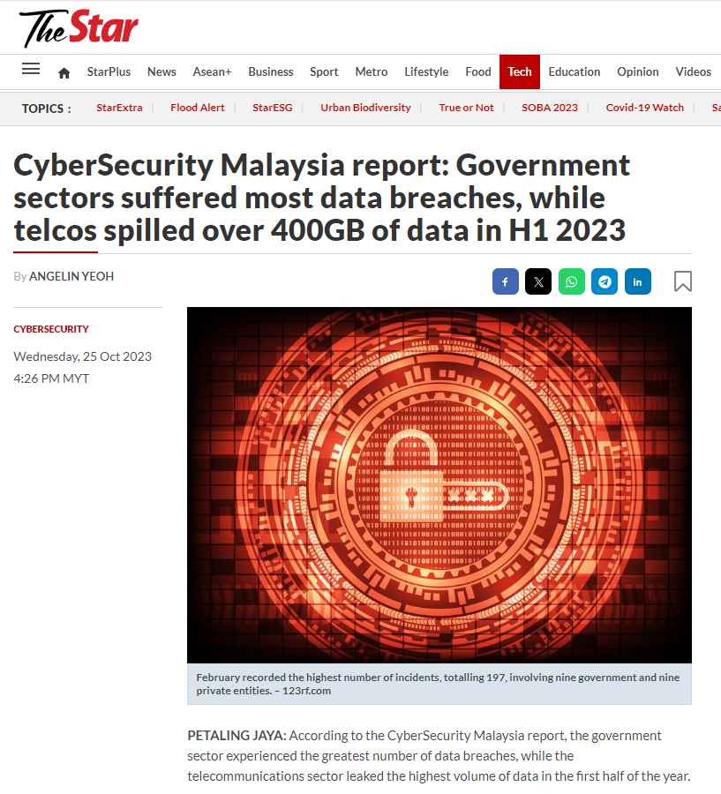
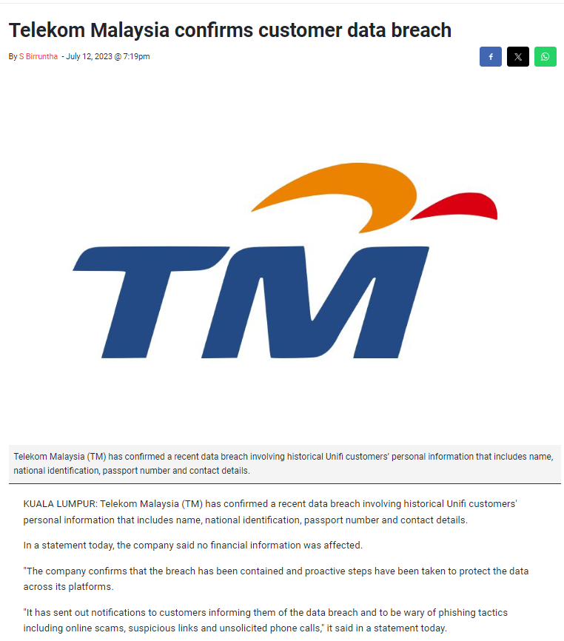
So why are they important ?
Organizations are legally obliged to protect customer and user data from being lost or stolen and ending up in the wrong hands.
It is crucial to preventing the reputational risk that accompanies a data breach. A high-profile hack or loss of data can result in customers losing trust in an organization and taking their business to a competitor.
This also runs the risk of serious financial losses, along with fines, legal payments, and damage repair in case sensitive data is lost. (Source: Fortinet)
Cryptography provides solution to resolve all the above-mentioned issues.

Slide 3
PART 1: DATA SECURITY

Slide 4
Outlines
Security goals.
Security attacks.
Security services and mechanisms.

Slide 5
Learning Objectives
In the end of this Part 1, students should be able:
To define the three security goals.
To define the security attacks that threaten the security goals.
To define the security services and how they are related to the three security goals.
To define the security mechanisms to provide the security goals.

Slide 6
SECURITY GOALS

Slide 7
Need for Information Security
Information Security requirements have changed in recent times.
Traditionally, they are provided by physical and administrative mechanisms.
Computer user requires automated tools to protect files and other stored information.
Use of networks and communications links requires measures to protect data during transmission.

Slide 8
Need for Information Security
Example:
Possible security holes:
Intruder capture the details as they travel.
Attacker gain access to the merchant database.
Event Happened:
An attacker intrude into a merchant database and obtained credit card numbers and released/sold some of the card numbers on the internet.
Consequences: Financial loss, and loss of goodwill.
Customer Id: 78910
Order Id: 90
Item Id: 156
Credit Card Number: 1234567890
Issued By: Visa
Valid Till: Jan 2026
…
Client
Server
Server Database

Slide 9
Need for Information Security
Privacy concerns:
Collecting info about people and misusing it
Data mining techniques – to process and tabulate the needed details about individuals Illegally sell the info.
No concern about the distance:
Remote breaking of bank servers.
Remote stealing credit card/ATM info.

Slide 10
Security Concepts
What is Security?
Taking measures that prevent assets from being damaged.
Taking measures to detect when, how and by whom an asset has been damaged.
Taking measures so that you can recover from a damage to assets.
Security refers to the act of taking measures to facilitate Prevention, Detection and Recovery of assets from being damaged.

Slide 11
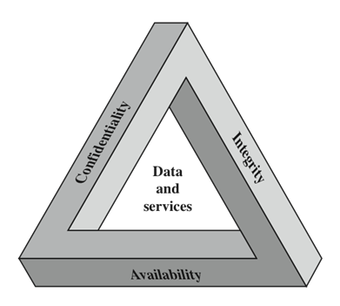
Security Goals - The CIA Triad
The CIA Triad:
C – Confidentiality
I – Integrity
A - Availability
# Please be reminded NOT to confuse Availability with Authentication.

Slide 12
The CIA Triad – Confidentiality
The assurance of the secrecy of the transmitted information, such that the content is readable/accessible only by both the intended sender and receivers
The transmitted data should be protected from passive attacks:
Snooping:
Unauthorized access to / interception of the transmitted data over insecure communication channel.
Traffic analysis:
Observation over the source, destination, frequency, length or other characteristics of the traffic on a communication facility by an attacker to guess the nature of the transmission.

Slide 13
The CIA Triad – Confidentiality
Example:
Confidential email message sent by A to B, but accessed by C without the permission or knowledge of A and B.
Type of attack – Interception
Interception causes loss of message (hence violates the confidentiality)
A
Secret
B
C

Slide 14
The CIA Triad – Integrity
The assurance that data received are the same as sent by an authorized entity.
The message from the sender to the receiver must travel without any alterations
Any changes to a message / transmitted data are detectable and verifiable by the entities.
The transmitted data should be protected from active attacks:
Modification – The data is modified / changed by an attacker for its benefits.
Masquerading – An entity is impersonated by an attacker.
Replaying – Obtain of the same message / data sent and replayed for its benefits.
Repudiation – The denial of entity (sender or receiver) that sent or received the message.

Slide 15
The CIA Triad – Integrity
Example:
User C tampers with an original message sent by user A to B. User C access and change its contents and relay it to B.
However, both users B and A have no idea about the changes done.
Type of attack: Modification
Modification causes loss of message integrity.
Ideal route of the message
A
B
Transfer RM 100
to D
Transfer RM1000
to C
Actual route of the message
C

Slide 16
The CIA Triad – Availability
The assurance of the resources / applications that must be available to authentic users all the time.
It depends on the proper management and control of system resources, as well as the access control service and other security services.
The availability of the data should be protected from active attacks:
Denial of Service (DoS)
The slow down of interruption of the service of a system, where an attacker may send many bogus requests to cause the server crashes, making the user / client to believe that the server is not responding.
The interception of requests made by the client, causing the client to send repetitive requests to overload the system.

Slide 17
The CIA Triad – Availability
Example:
Due to intentional actions of an unauthorized user C, an authorized user A may not be able to contact a server computer B
Type of attack: Interruption
Interruption puts the availability of resources in danger.
A
B
C

Slide 18
SECURITY THREATS / ATTACKS

Slide 19
OSI Security Architecture
ITU–T (International Telecommunication Union – Telecommunication Standardization Sector) Recommendation X.800 “Security Architecture for OSI”:
Defines a systematic way of defining and providing security requirements and characterizing the approaches to satisfy the requirements.
Useful to the managers as a way of organizing the task of providing security .
Computer and communication vendors develop security features for their products and services based on this.
Information security is about how to prevent attacks, or failing that, to detect attacks on information-based systems
Focuses on 3 aspects of information security: Security attack, Security service, and Security mechanism.

Slide 20
OSI Security Architecture
Security Attack
Any action that compromises the security of information owned by an organization.
Security Service
A processing or communication service that enhances the security of the data processing systems and information transfers of an organization.
To counter security attacks, and may use one or more security mechanisms.
Security Mechanism
A process or a device incorporating such a process that is designed to detect, prevent, or recover from a security attack.

Slide 21
OSI Security Architecture
Definitions (RFC 2828, Internet Security Glossary):
Threat:
A potential for violation of security, which exists when there is a circumstance, capability, action, or event that could breach security and cause harm.
A threat is a possible danger that might exploit a vulnerability.
Attack:
An assault on system security that derives from an intelligent threat.
An intelligent act that is a deliberate attempt to evade security services and violate the security policy of a system.
The terms threat and attack are commonly used to mean the same thing in the literature.

Slide 22
Security Threats / Attacks
General classification according to theoretical concepts behind attacks:
Interruption: Asset of system becomes lost/unavailable that puts the availability of resources in danger.
Interception: Unauthorized access to an asset of the system that causes loss of message confidentiality.
Modification: Tampering the asset of the system by unauthorized party which causes loss of message integrity.
Fabrication: Skillful modifications of the system that could be indistinguishable from real thing which is possible in absence of proper authentication mechanisms.

Slide 23
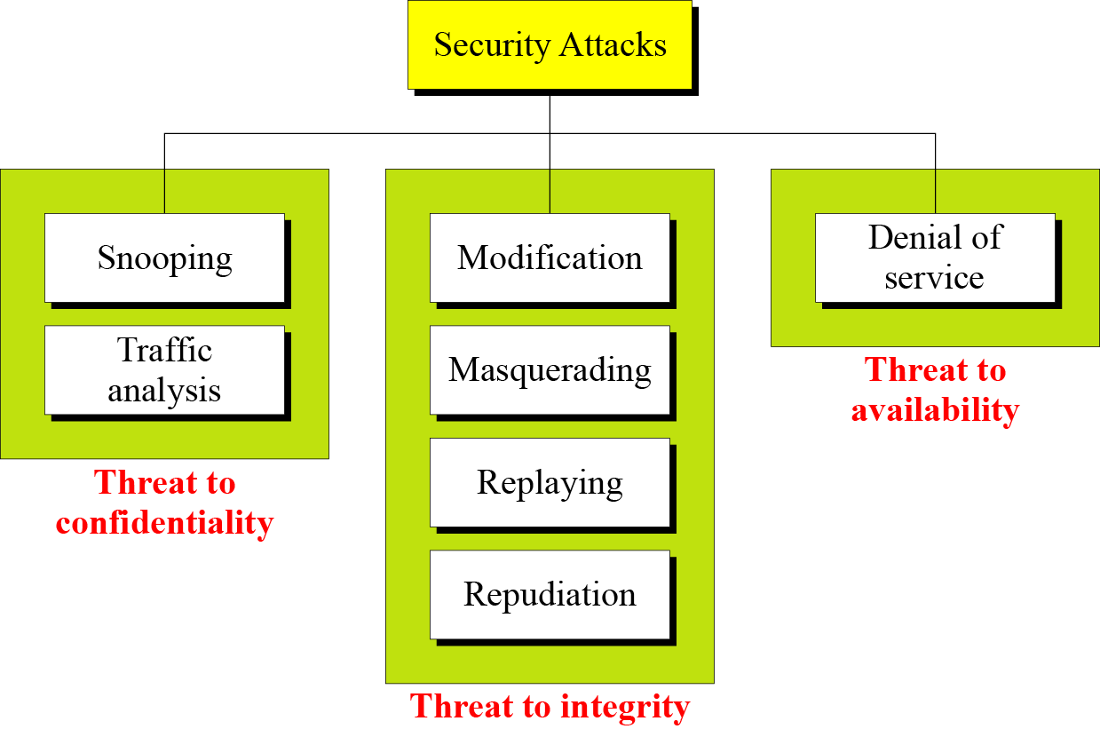
Security Threats / Attacks
Taxonomy of attacks with relation to security goals. (Left diagram).
The attacks can also be classified according to practical approach used by attackers:
Passive Attacks
Active Attacks

Slide 24
Security Threats / Attacks – Passive Attacks
Passive attacks do not involve any modifications to the contents of an original message.
Attacker indulges in monitoring the data transmission and aims to obtain information in transit.
This attack is harder to detect, since attack does not involve actively in the communication.
Two common passive attacks:
Release of message contents.
Traffic analysis.

Slide 27
Security Threats / Attacks – Active Attacks
Active attack involves modification of the original message or the creation of false message.
This attack cannot be prevented easily, since the attacks can be in the form of interruption, modification and fabrication.
Detected with some effort and attempts can be made to recover from them
Common active attacks:
Masquerade
Replay attacks
Modification of message
Denial of service

Slide 32
SECURITY SERVICES

Slide 33
Security Services - Analogy
Related to a particular message.
Assume that Alice wants to send a cheque to Bob. Alice will write the cheque, put it inside the envelope and send it to Bob. Now the concerns of Alice and Bob:
Alice would like to ensure that no one except Bob gets the envelope – principle of confidentiality (that assets are accessible only by authorized part).
Alice and Bob would like to make sure that no one can tamper with the contents of the cheque – principle of integrity (that assets can be modified only by authorized party or in authorized ways).
Bob would like to be assured that the cheque has come from Alice and not from someone else – principle of authentication.
Bob deposits cheque, money is transferred and then Alice refuses having sent the check. Court of law will use Alice’s signature to settle the dispute – principle of non-repudiation.

Slide 34
Security Services - Analogy
Related to overall system.
Access Control
Availability
Assets are accessible to authorized party

Slide 35
Security Services – X.800 (Overall)
X.800 has defined five security services provided by a protocol layer of a communicating open systems, which ensures adequate security of the systems of data transfer.
More information can be found in RFC 2828 (Request for Comments: 2828).

Slide 36
Security Services – Confidentiality
The protection of data from unauthorized disclosure.
Connection confidentiality: The protection of all user data on a connection
Connectionless confidentiality: The protection of all user data in a single data block
Selective-Field Confidentiality: The confidentiality of selected fields within the user data on a connection or in a single data block
Traffic Flow Confidentiality: The protection of the information that might be derived from observation of traffic flows

Slide 37
Security Services – Authentication
The assurance that the communication entity is the one that it claims to be.
Single message:
To assure the recipient that the message is from the source that it claims to be from
Ongoing interaction:
At the time of connection initiation, the service assures that the two entities are authentic (each is the entity that it claims to be).
The service must assure that the connection is not interfered with in such a way that a third party can masquerade as one of the two legitimate parties for the purposes of unauthorized transmission or reception.

Slide 38
Security Services – Authentication
Example:
User C, posing as User A sending a funds transfer request to bank B from A’s account to C’s account
Type of attack – Fabrication
Fabrication is possible in the absence of proper authentication mechanisms.
A
I am user A
B
C

Slide 39
Security Services – Authentication
Peer Entity Authentication:
Used in association with a logical connection to provide confidence in the identity of the entities connected.
It is provided for use at the establishment of the connection or during the data transfer phase of a connection.
Data origin authentication:
In a connectionless transfer, provides assurance that the source of received data is as claimed.
It supports applications like electronic mail.

Slide 40
Security Services – Integrity
The assurance that data received are exactly as sent by an authorized entity (i.e., contain no modification, insertion, deletion, or replay).
Connection Integrity with Recovery
Provides for the integrity of all user data on a connection and detection of any modification, insertion, deletion, or replay of any data within an entire data sequence, with recovery attempted
Connection Integrity without Recovery
Same as above but only provide detection without recovery

Slide 41
Security Services – Integrity
Selective-Field Connection Integrity
Provides for the integrity of selected fields within the user data of a data block transferred over a connection to determine whether the selected fields have been modified, inserted, deleted or replayed.
Connectionless Integrity
Provides for the integrity of a single connectionless data block that can be in the form of detection of data modification and detection of limited form of replay.
Selective-Field Connectionless Integrity
Provides for the integrity of selected fields within a single connectionless data block to determine whether the selected fields have been modified.

Slide 42
Security Services – Non-Repudiation
Provides protection against denial by one of the entities involved in a communication of having participated in all or part of the communication.
Nonrepudiation, Origin
Proof that the message was sent by the specified party.
Nonrepudiation, Destination
Proof that the message was received by the specified party.

Slide 43
Security Services – Non-Repudiation
Example:
User A could send a fund transfer request to a bank over the internet.
After the bank performs the fund transfer as per A’s instructions, A could repudiate or denies funds transfer instruction.
* Non–repudiation does not allow the sender of a message to refute the claim of not sending that message.

Slide 44
Security Services – Access Control
The prevention of unauthorized use of a resource (i.e., this service controls who can have access to a resource, under what conditions access can occur, and what those accessing the resource are allowed to do).
Example:
Students in my Google Classroom will be able to only view all the materials that uploaded in the Shared folder but disallowed to make any changes or upload anything from their side.

Slide 45
Security Services – Access Control
Two common areas in access control:
Role management.
Concentrates on the user side on what a user can (or cannot) do.
Rule management.
Concentrates on the resources side on which resource is accessible by a particular user and under what circumstances that he can access to it.

Slide 46
SECURITY MECHANISMS

Slide 47
Security Mechanisms
Recommendation by X.800 to provide security services defined previously.
Objective:
To detect, prevent, or recover from a security attack.
Specific means of implementing one or more security service
No single mechanism that will support all services required
However, one element underlies many of the security mechanisms in use – Cryptographic Techniques

Slide 48
Security Mechanisms – X.800 (Overall)
X.800 has defined two major groups of security mechanisms:
Specific Security Mechanisms.
Incorporated into the appropriate protocol layer to provide some OSI security services.
Pervasive Security Mechanisms.
Not specific to any OSI protocol layer or any OSI security service.
* In this course, we DO NOT consider the pervasive group.

Slide 49
Security Mechanisms – X.800
Encipherment
Use of mathematical algorithms to transform data into not intelligible form.
Transformation and recovery depend on an algorithm and zero or more encryption keys.
Digital Signature
Data added to a data unit that allows the receiver to prove the source and integrity of data and protect against forgery.
Access Control
Mechanisms to enforce access rights to resources.
Notarization
Use of trusted third party (TTP) to assure certain properties of data exchange.

Slide 50
Security Mechanisms – X.800
Data Integrity
Mechanisms to assure the integrity of a data unit or a stream of data.
Authentication Exchange
Mechanism to ensure the identity by information exchange.
Traffic Padding
Insertion of bits in a data stream to avoid traffic analysis.
Routing Control
Selection of physically secure routes for data.
Allow routing change for the suspected violation of security.

Slide 51
Security Services and Mechanisms
The relationship between security services and security mechanisms:

Slide 52


Slide 53
NETWORK SECURITY MODELS

Slide 54
Model for Network Security
It models an information flowing over an insecure communications channel, in the presence of possible opponents (attackers/adversaries).
An appropriate security transformation (encryption algorithm) can be used, with suitable keys (a secret information shared only by the authorized entities), possibly negotiated using the presence of a trusted third party.
Trusted Third Party (TTP):
A third party that may be responsible for key distribution.
A third party that may be needed to authenticate the communicating parties/message sent.

Slide 56
Model for Network Security
Four basic tasks in designing a security service:
Design a suitable algorithm (via cryptography) for the security-related transformation. The algorithm should be impossible (or at least difficult) for an opponent to defeat its purpose.
Generate the secret information (that is, the secret key) used with the algorithm.
Develop methods (common via a TTP) to distribute and share the secret information.
Specify a protocol enabling the principals to use the transformation and secret information for a security service.

Slide 57
Network Access Security Model
A model that is concerned with controlled access to information or resources on a computer system, in the presence of possible opponents.
Two possible kinds of threats:
Information access threats: It intercepts or modifies data on behalf of users who should not have access to that data.
Service threats: It exploits service flaws in computers to inhibit use by legitimate users.
Appropriate controls are needed on the access and also within the system, to provide suitable security. In some cases, cryptographic techniques are useful too.

Slide 58
Network Access Security Model

Slide 59
Network Access Security Model
Two broad categories of security mechanisms needed to cope with unwanted access:
Select appropriate gatekeeper functions:
To include password-based login procedures to allow only authorized users.
To include screening logic to detect and reject worms, viruses and similar attacks.
Implement internal security controls to monitor activity and analyse stored information to detect the presence of unwanted intruders or virus.

Slide 60
PART 2: CRYPTOGRAPHY

Slide 61
Outlines
Basic terminologies.
Kerckhoffs’ Principle.
Security Levels.
Types of Cryptography.
Types of Cryptanalysis.

Slide 62
Learning Objectives
In the end of this Part 2, students should be able:
To understand the terms used in describing cryptography.
To understand the Kerckhoffs’ principle and its importance in cryptology.
To understand the difference of the security levels defined in cryptography.
To understand and differentiate different types of cryptography.
To understand and differentiate different types of cryptanalysis.

Slide 63
BASIC CONCEPTS

Slide 64
Basic Terminology – Cryptology
Cryptology is a study covers two major areas:
Cryptography
A word with Greek origins – secret writing.
The science and art of transforming messages to make them secure (unreadable by unauthorized users) and immune to attacks (irrecoverable by attackers).
Practitioners in this area is called Cryptographers.
Cryptanalysis
Techniques used for deciphering a message without any knowledge of the enciphering details (without using keys).
Practitioners in this area is called Cryptanalysts.

Slide 65
Basic Terminology – Cryptology
Plaintext or Message
The original intelligible message understood by anyone. It can be understood by the sender, the recipient, and by whoever gets an access to that message.
Ciphertext
The encrypted message output from some algorithms. It is a random string of data that is unintelligible.
Encryption Algorithm
An algorithm used to transform plaintext into ciphertext.
Decryption Algorithm
An algorithm used to transform ciphertext into plaintext.

Slide 66
Basic Terminology – Cryptology
Secret Key
A secret information used in encryption known only to sender/receiver.
Encryption (Encipherment)
The process of converting from plaintext to ciphertext using a cipher and secret key(s).
Decryption (Decipherment)
The process of recovering plaintext from ciphertext using a cipher and secret key(s).

Slide 67
Kerckhoffs’ Principle
In the 19th century, a Dutch-born cryptographer Auguste Kerckhoffs came out one of the most important design principles for encryption, which now famously known as the Kerckhoffs’ principle, states that:
The cipher method (encryption) must NOT be required to be secret, and it must be able to fall into the hands of the enemy without inconvenience.

Slide 68
Kerckhoffs’ Principle
In other words, the security of an cryptographic algorithm lies on the secrecy of the KEYs, not the algorithm itself.
Guessing / finding the key must be difficult for an attacker. Hence, the key domain must be large enough to achieve such an objective.

Slide 69
Security Levels
Unconditional Security
Regardless of endless computer power, the ciphertext cannot be broken since the ciphertext provides insufficient information to uniquely determine the corresponding plaintext.
No encryption algorithm is unconditionally secure except the one-time pad scheme.
Computational Security
The cost of breaking the cipher exceeds the value of the encrypted information.
The time required to break the cipher exceeds the useful lifetime of the information.
If either of the above criteria is met, an encryption scheme is said to be computationally secure.

Slide 70
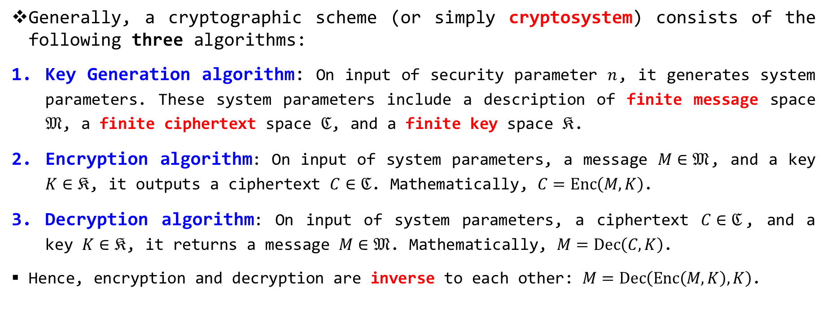
Cryptography (Overall)
Generally, a cryptographic scheme (or simply cryptosystem) consists of the following three algorithms:
Key Generation algorithm: On input of security parameter $n$, it generates system parameters. These system parameters include a description of finite message space $𝔐$, a finite ciphertext space $ℭ$, and a finite key space $𝔎$.
Encryption algorithm: On input of system parameters, a message $M∈𝔐$, and a key $K∈𝔎$, it outputs a ciphertext $C∈ℭ$. Mathematically, $C=Enc\left(M,K\right)$.
Decryption algorithm: On input of system parameters, a ciphertext $C∈ℭ$, and a key $K∈𝔎$, it returns a message $M∈𝔐$. Mathematically, $M=Dec\left(C,K\right)$.
Hence, encryption and decryption are inverse to each other: $M=Dec\left(Enc\left(M,K\right),K\right)$.

Slide 71
Cryptography (Overall)
Different cryptosystem features different settings in their algorithms:
Amount of keys involves:
Hash Functions: 0 key.
Symmetric cryptography: 1 key.
Asymmetric cryptography: 2 keys.
Types of encryption operations: Substitution, transposition, product, etc.
Techniques in processing the plaintext (message):
Stream cipher.
Block cipher.

Slide 72
SYMMETRIC CRYPTOGRAPHY

Slide 73
Symmetric Cryptography
Also known as secret/private-key cryptography.
Both sender and receiver share a common secret key.
If this key is disclosed, then the communication is compromised.
It relies on the fundamental building blocks of substitution and permutation (transposition).
It is symmetric since both parties are equally having the same secret key.
Hence does not protect sender from receiver forging a message (integrity) and claiming it is sent by sender (non-repudiation).
All classical encryption algorithms are secret-key type and were only the type prior to invention of public-key in the 1970s.

Slide 75
Ingredients of Symmetric Cryptography
Plaintext: The original intelligible message or data.
Encryption algorithm: It performs various transformations on the plaintext.
Secret key: It controls the exact substitutions or transformations used in encryption algorithm. The key is a value independent of the plaintext and of the algorithm. The algorithm produces different output depending on the specific key used at the time (random / probabilistic).
Ciphertext: An output that depends on the input plaintext and the secret key.
Decryption algorithm: It is an inverse of encryption algorithm that takes the ciphertext and secret key and returns the original plaintext.

Slide 76
Model of Symmetric Cryptography

Slide 77
Requirements of Symmetric Cryptography
For a secure use of symmetric cryptography:
A strong encryption algorithm is needed.
The opponent should be unable to decrypt ciphertext or to discover the key even if he or she is in possession of several ciphertexts together with the plain text that produced each ciphertext.
The secret key should be known only to sender and receiver.
A secure secret-key distribution is required to transfer the keys to the intended receiver.
The secret key must be kept and protected securely from any malicious party.

Slide 78
ASYMMETRIC CRYPTOGRAPHY

Slide 79
Asymmetric Cryptography
Also known as Public-key Cryptography.
Two keys are used: one public key and one private key.
To send a secure message, sender first encrypts the message using receiver’s public key.
To decrypt the message, receiver uses his/her own private key.
It is asymmetric since anyone knowing the public key can encrypt messages or verify signatures, but cannot decrypt messages or create signatures
It uses clever application of number theory (mathematics) concepts.
It complements rather than replaces private key cryptosystem.

Slide 81
Asymmetric Cryptography - Analogy
Consider the following analogies using padlocked boxes:
Private key cryptography involve the sender putting a message in a box and locking it, sending that to the receiver, and somehow securely also sending them the key to unlock the box.
The radical advance in public key cryptography change the environment:
The receiver sends an unlocked box (his public key) to the sender, who puts the message in the box and locks it (easy and having locked, it is impossible to take out the message anymore), and sends the locked box to the receiver who can unlock it (also easy) with his private key.
An attacker would have to identify the private key to unlock the box (hard).

Slide 82
Ingredients of Asymmetric Cryptography
Plaintext: The original intelligible message or data.
Encryption algorithm: It performs various transformations on the plaintext.
Public-Private keys: A pair of keys that have been selected so that if one is used for encryption, the other is used for decryption. The exact transformations performed by the algorithm depend on the public or private key that is provided as input
Ciphertext: An output that depends on the input plaintext and the secret key.
Decryption algorithm: It is an inverse of encryption algorithm that takes the ciphertext and secret key and returns the original plaintext.

Slide 84
Asymmetric Cryptography – Essential Steps
Each user generates a pair of keys to be used for the encryption and decryption of messages.
Each user places one of the two keys in a public register or other accessible file. This is the public key. The companion key is kept private. As the previous figure suggests, each user maintains a collection of public keys obtained from others.
If Bob wishes to send a confidential message to Alice, Bob encrypts the message using Alice’s public key.
When Alice receives the message, she decrypts it using her private key. No other recipient can decrypt the message because only Alice knows Alice’s private key.

Slide 85
Symmetric vs Asymmetric Cryptography

Slide 87
CRYPTANALYSIS

Slide 88
Cryptanalysis
As opposed to cryptography, cryptanalysis is art and science of breaking the cryptography.
In general, there are two approaches in attacking cryptography:
Brute-Force attack:
The attacker tries every possible key on a piece of ciphertext until an intelligible translation into plaintext is obtained. On average, half of all possible keys must be tried to achieve success.
Cryptanalysis:
It relies on the nature of the algorithm in addition some knowledge of the general characteristics of the plaintext or plaintext-ciphertext pairs. This attack attempts to a specific plaintext, or to deduce the key used in the cryptography.

Slide 89
Cryptanalysis – Brute Force Attack

Slide 90
Cryptanalysis – Cryptanalytic Attacks
In general, there are five common types of cryptanalytic attacks based on the amount of the information (environment) an attacker has. These attacks are ranked from the weakest to the strongest.
Ciphertext-only Attack (COA) – the weakest
Known-Plaintext Attack (KPA)
Chosen-Plaintext Attack (CPA)
Chosen-Ciphertext Attack (CCA)
Chosen-Text Attack – the strongest
The chosen text attack is always analysed under CCA in security analysis.

Slide 92
Cryptanalysis – Ciphertext-Only Attack
The attacker (Eve) has access to only some ciphertext, and tries to find the corresponding plaintext, or the key.
Possible attacks:
Brute force / exhausted key search: Eve tries to decrypt the ciphertext using all possible keys until the plaintext makes sense.
Prevention: Apply a very large key size.
Statistical attack: Eve tries to detect some inherent characteristics of the language pattern (For example, letter ‘E’ has the highest frequency in English text) to search for the key used in the encryption.
Prevention: Hide the characteristics of the language.
Pattern attack: Exploit the pattern of the ciphertext.
Prevention: Randomize the output ciphertext.

Slide 94
Cryptanalysis – Known-Plaintext Attack
The attacker (Eve) has access to some plaintext-ciphertext pairs, in addition to the intercepted ciphertext that she wants to break.
The collected pairs are used to break the NEXT intercepted ciphertext, assuming the key has NOT changed.
All the attacks launched in COA are also applicable here.
This attack is easier since Eve has now more information to aid her, but less likely to happen since sender may have changed the encryption key, or the previous message is not revealed.

Slide 95
Cryptanalysis – Chosen-Plaintext Attack
The attacker (Eve) has access to the plaintext-ciphertext pairs CHOSEN by herself.
Eve can choose any plaintext of her choice and ask for encryption to obtain the corresponding ciphertext. The output ciphertext is collected and used to attack the NEXT intercepted ciphertext.
For example: Eve has access to the Sender’s computer. She can choose some plaintext and intercept the output ciphertext. Note that Eve does not have the encryption key.
This attack is much easier to implement, but much less likely to happen.

Slide 97
Cryptanalysis – Chosen-Ciphertext Attack
The attacker (Eve) has access to the plaintext-ciphertext pairs CHOSEN by herself.
Eve can choose any ciphertext of her choice and ask for decryption to obtain the corresponding plaintext. The output plaintext is collected and used to attack the NEXT intercepted ciphertext.
For example: Eve has access to the Receiver’s computer. She can choose some ciphertext and intercept the decrypted plaintext. Note that Eve does not have the decryption key.
This attack is even much easier to implement, but very unlikely to happen.

Slide 98
Cryptanalysis – Chosen-Text Attack
A combination of both CPA and CCA environments.
The attacker (Eve) acquires the greatest (complete) attacking ability.
The final target is remains the same:
She can deduce the plaintext from the intercepted ciphertext.
She can deduce the encryption and/or decryption keys used in the communication.
Also the easiest and provide highest ability to the attacker, this attack is rarely likely to happen.

Slide 99
Cryptanalysis – Security vs Attack
In cryptography, when proposing or designing a cryptosystem, often the security analysis is given to support its protection against specific attack.
In most cases, all designed cryptosystems are looking for CCA security. That is we assume an attacker has the highest attacking ability, and then we prove that he will eventually failed in achieving his target.
If one can show that a cryptosystem is secure against CCA, then the system is considered safe to be used in practice.

Slide 100
OTHER CLASSICAL ENCRYPTION TECHNIQUE

Slide 101
Steganography – Classical Techniques
A method of concealing the existence of the original message rather than make it unreadable but does not change the original message.
Common classical techniques:
Character marking: Uses only a subset of letters/words in a longer message marked in some way.
Invisible ink: It leaves no visible trace until heat, or some chemical is applied on the paper.
Pin punctures: Invisible unless the paper is held in front of light.
Typewriter correction ribbon: It types with correction tape between lines typed with black ribbon – visible only under a strong light.
Photographing: The secret message is snapped and reduced to a size of a dot and inserted in place of regular periods at the end of sentences.
Hiding in LSB: In either graphic image or sound file.

Slide 102
Steganography – Modern Techniques
Secret binary information can be inserted into any form of data (text, image, audio, or video) during digitization processes.
Hidden information can be used for secrecy, to protect copyright, prevent tampering or add extra information.

Slide 103
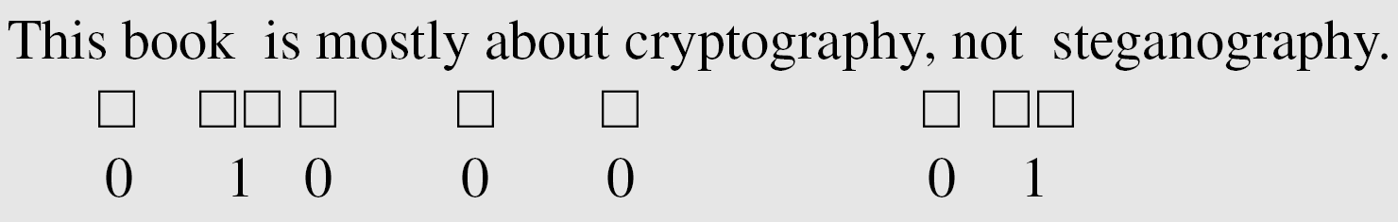
Steganography – Modern Techniques
Example 1: Covering data with text.
Single space between words represents binary digit 0.
Double space between words represents binary digit 1.
Above hides the 8-bit binary representation of the ! in ASCII code (0100001)

Slide 104
Steganography – Modern Techniques
Example 2: Using dictionary.
Use a dictionary of words organized according to their grammatical usages.
It assumes a dictionary contain 2 articles, 16 verbs, 32 nouns.
Pattern agreed: article-noun-verb-article-noun.
Divide the secret binary data into 16-bit chunks.
Bits | Representations
1 | First article
2 – 6 | First noun
7 – 10 | Verb
11 | Second article
12 – 16 | Second noun

Slide 105
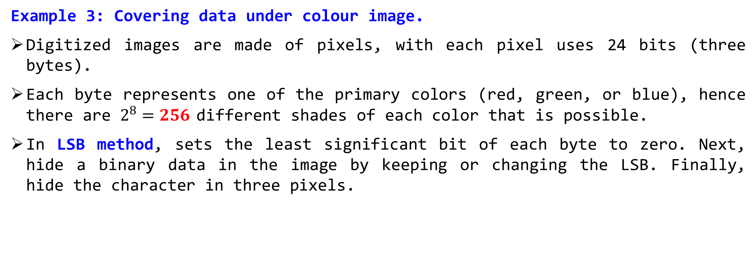
Steganography – Modern Techniques
Example 3: Covering data under colour image.
Digitized images are made of pixels, with each pixel uses 24 bits (three bytes).
Each byte represents one of the primary colors (red, green, or blue), hence there are $2^{8}=256$ different shades of each color that is possible.
In LSB method, sets the least significant bit of each byte to zero. Next, hide a binary data in the image by keeping or changing the LSB. Finally, hide the character in three pixels.

Slide 106
Steganography – Drawbacks & Remedy
Drawbacks:
High overhead to hide relatively few information bits.
Once the system is discovered, it becomes worthless.
Remedy:
Insertion method can depend on some sort of key.
First encrypt the message and then hide using steganography.

Slide 107
Main References for Chapter 1
Forouzan, B.A. “Introduction to Cryptography and Network Security”, Third Edition, McGraw-Hill, 2008.
Stallings, W. “Cryptography and Network Security: Principles and Practices”, Fifth Edition, Pearson Prentice Hall, 2011.

Slide 108
~ THE END ☺ ~

